Slide 1
Manchester
Raspberry Jam 20
June 2014
2 years of Raspberry Jam!

Slide 2
2 Years of McrRaspJam!
2 years this week since the
first ever Raspberry Jam

Slide 3
Last Time...

Slide 4
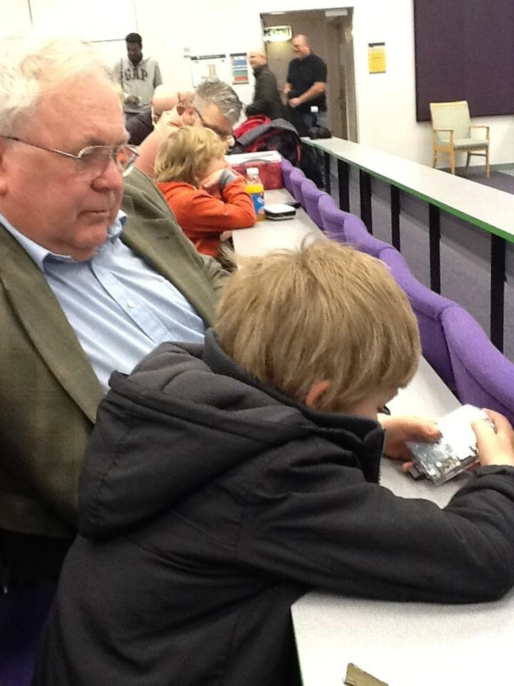
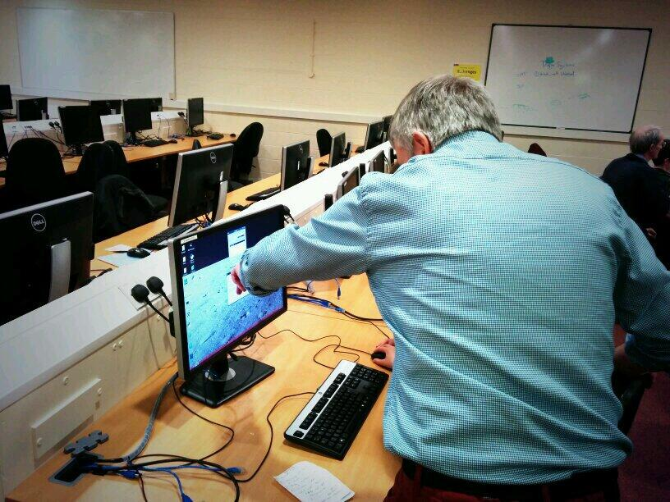
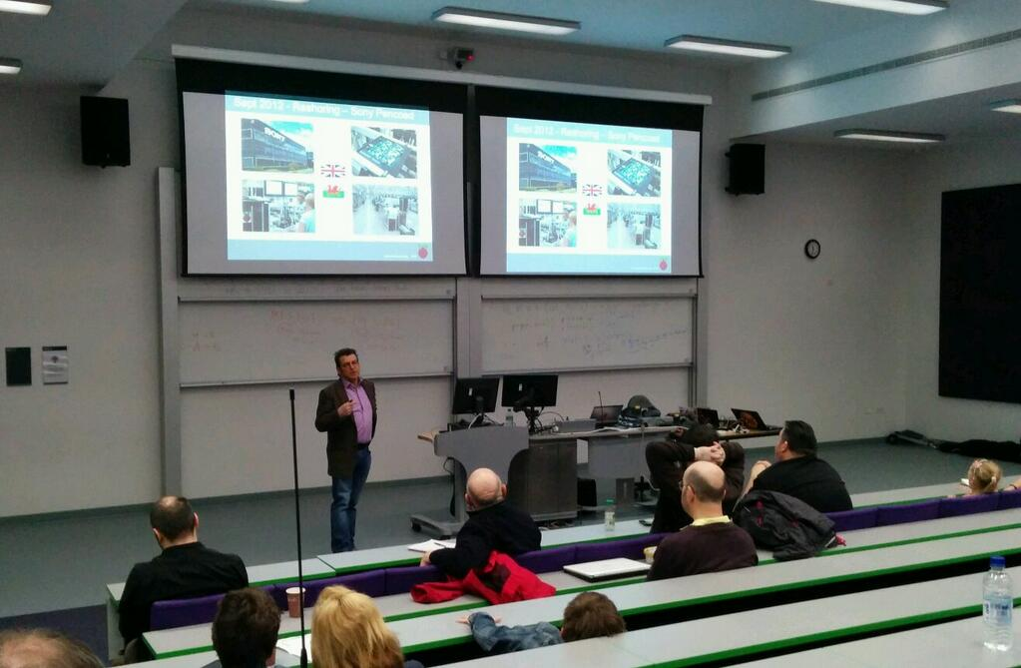
UoM Raspberry Jam

Slide 5
In The News...

Slide 6
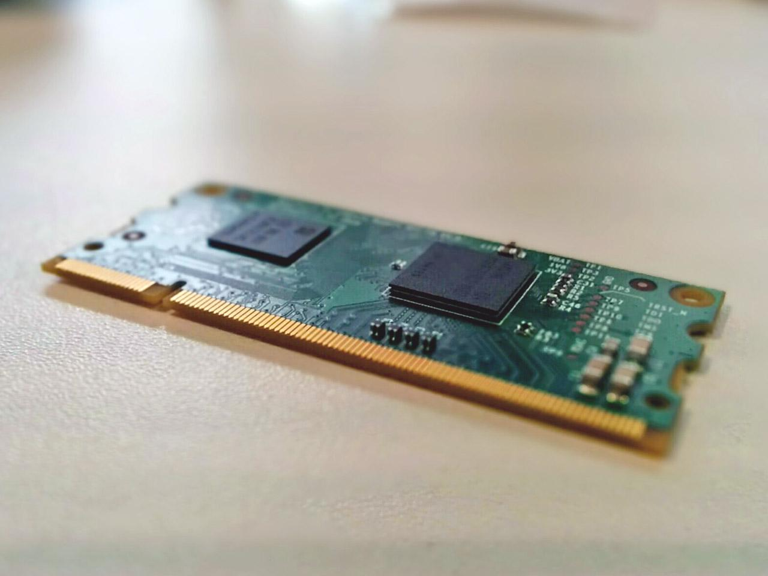
Compute Module Released
http://www.raspberrypi.org/raspberry-pi-compute-module-new-product/

Slide 7
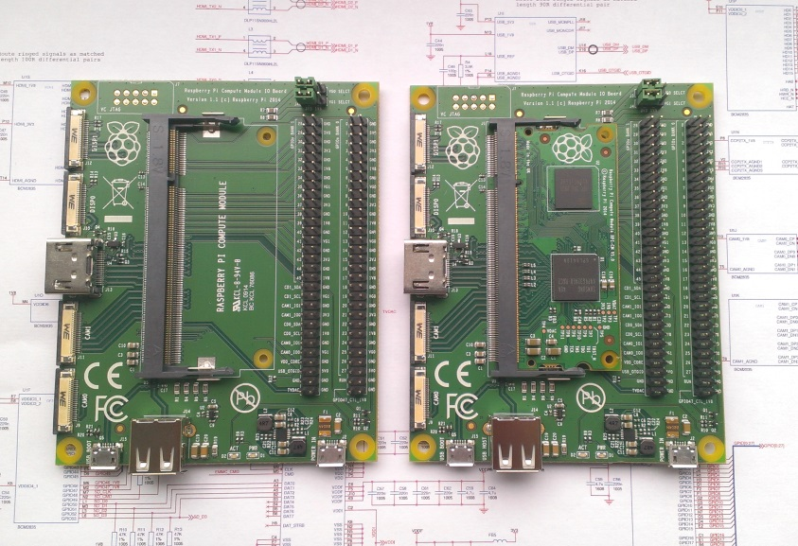
Compute Module Released
http://www.raspberrypi.org/raspberry-pi-compute-module-new-product/

Slide 8
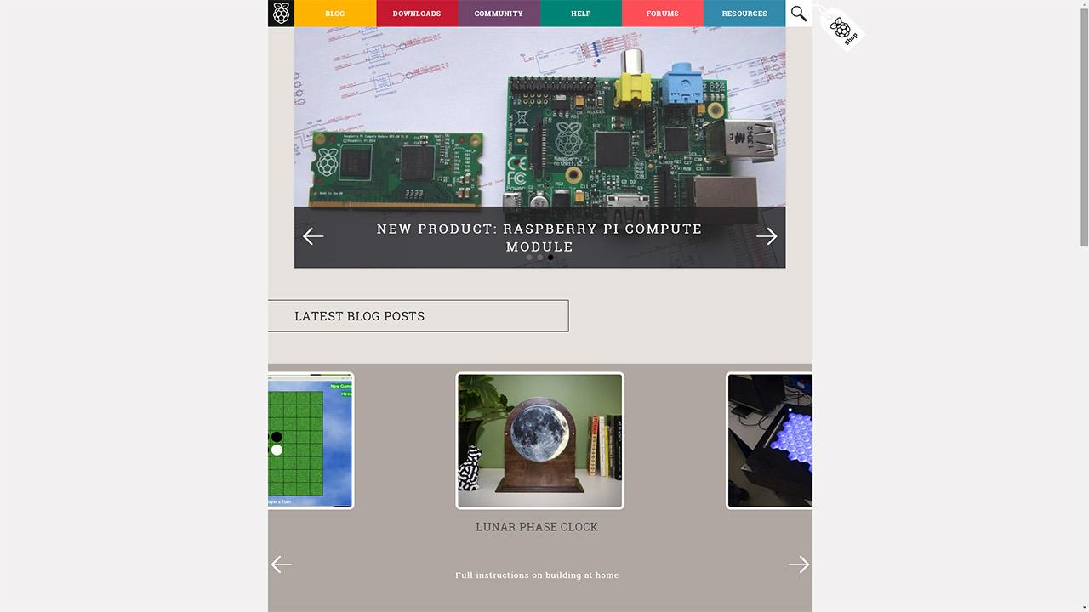
New raspberrypi.org Design
http://www.raspberrypi.org/welcome-to-our-new-website/

Slide 9
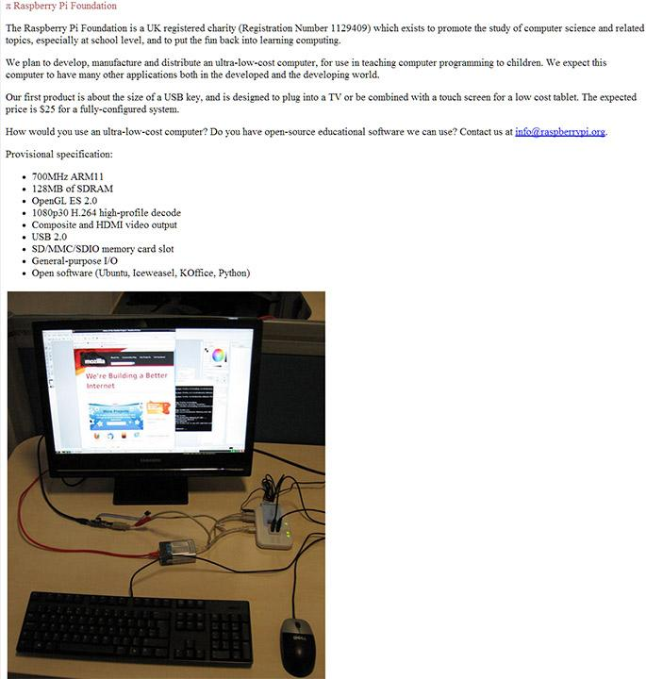
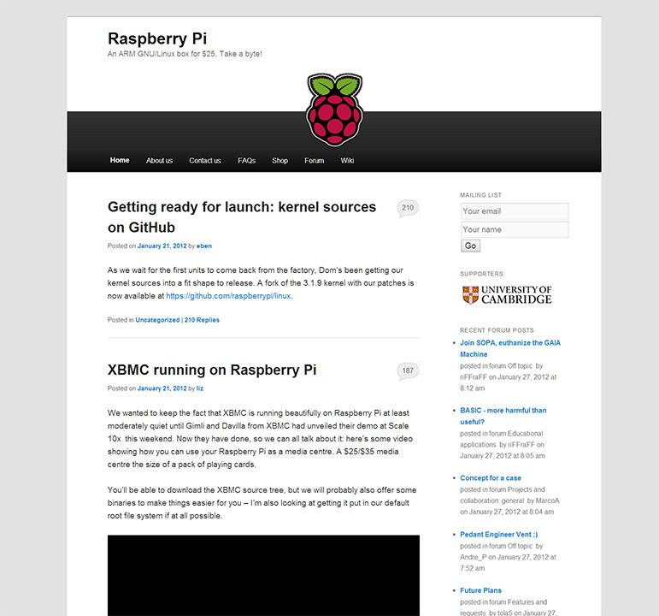
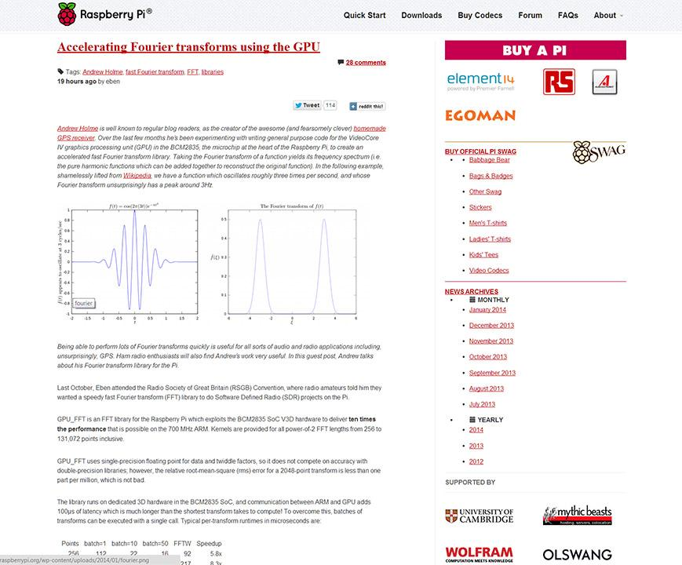
New raspberrypi.org Design
http://www.raspberrypi.org/welcome-to-our-new-website/

Slide 10
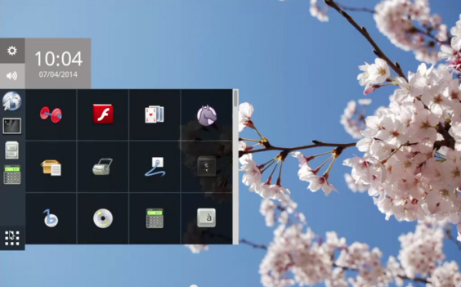
Maynard Desktop Manager
http://www.raspberrypi.org/preview-the-upcoming-maynard-desktop/

Slide 11
Projects...

Slide 12
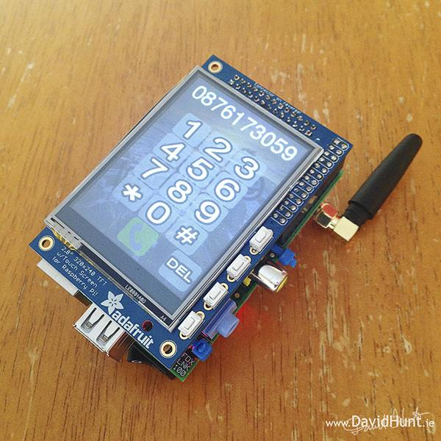
PiPhone
http://www.davidhunt.ie/piphone-a-raspberry-pi-based-smartphone/

Slide 13
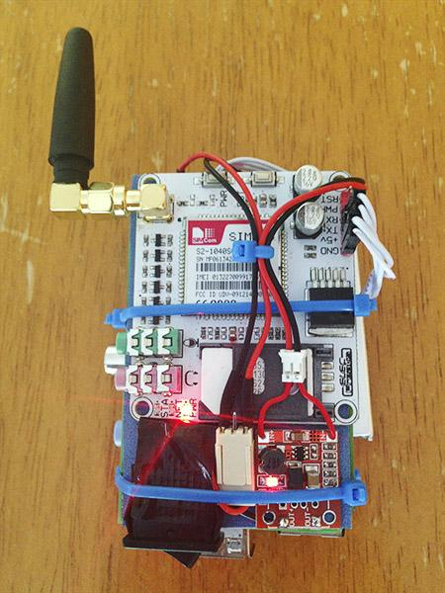
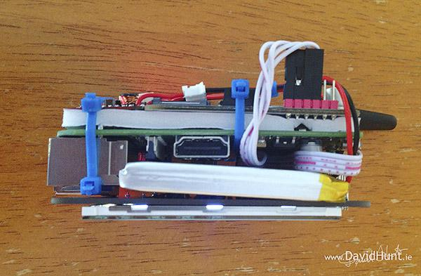
PiPhone
http://www.davidhunt.ie/piphone-a-raspberry-pi-based-smartphone/

Slide 14
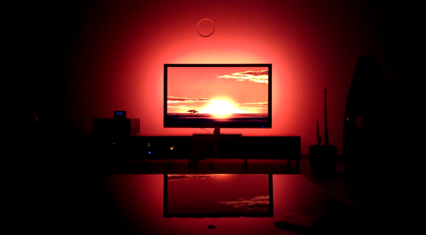
DIY Ambilight
http://techtalk.christian-moser.ch/wordpress/?p=427

Slide 15
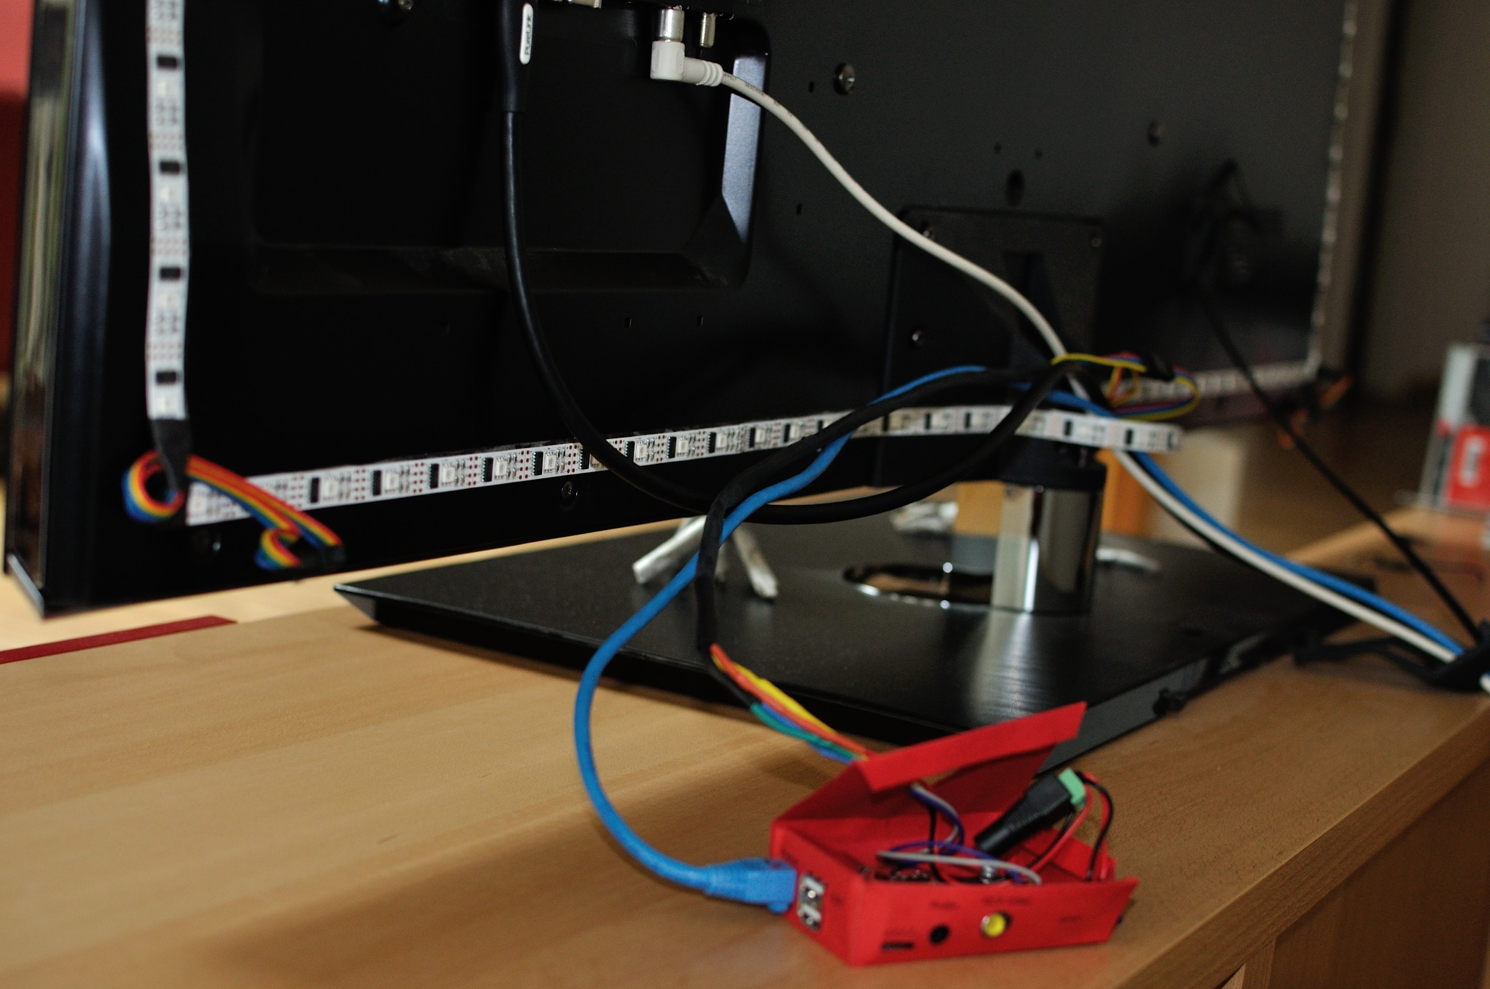
DIY Ambilight
http://techtalk.christian-moser.ch/wordpress/?p=427

Slide 16
Coming soon...

Slide 17
Manchester Raspberry Jam 21
Very hopefully back at UoM!
Date not final (21st July planned)

Slide 18
For today...

Slide 19
Today:
Downstairs only
Pizza by 1pm

Slide 20
Thanks to our sponsors:
Sue Cocker
Jose Morell Ducos
Simon Walters
Rosemary Williams

Slide 21
Finally...
Tweet your photos and creations:
#McrRaspJam
Download the slides:
http://bit.ly/mcrraspjam20

